Slide 1
Options
Application Guide
Version: 290426

Slide 2
Table of Contents
Options – User Guide
Tab
  Home
  Portfolio
  Trade
  Watchlist
  Markets
  Menu - How do I subscribe to live options chains?
Trade
  How to use the Options Wizard?
  How to trade using the Options Chain?
  How do I modify or cancel an options order?

Slide 3
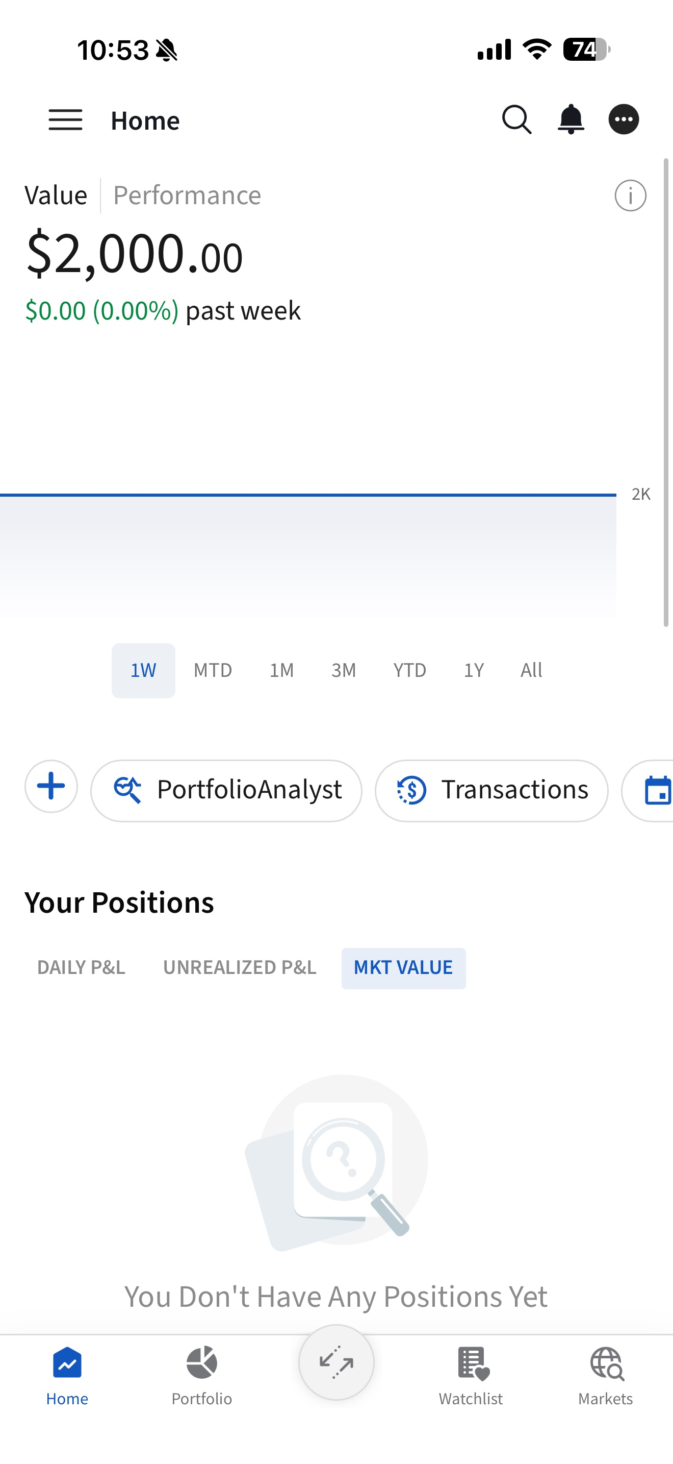
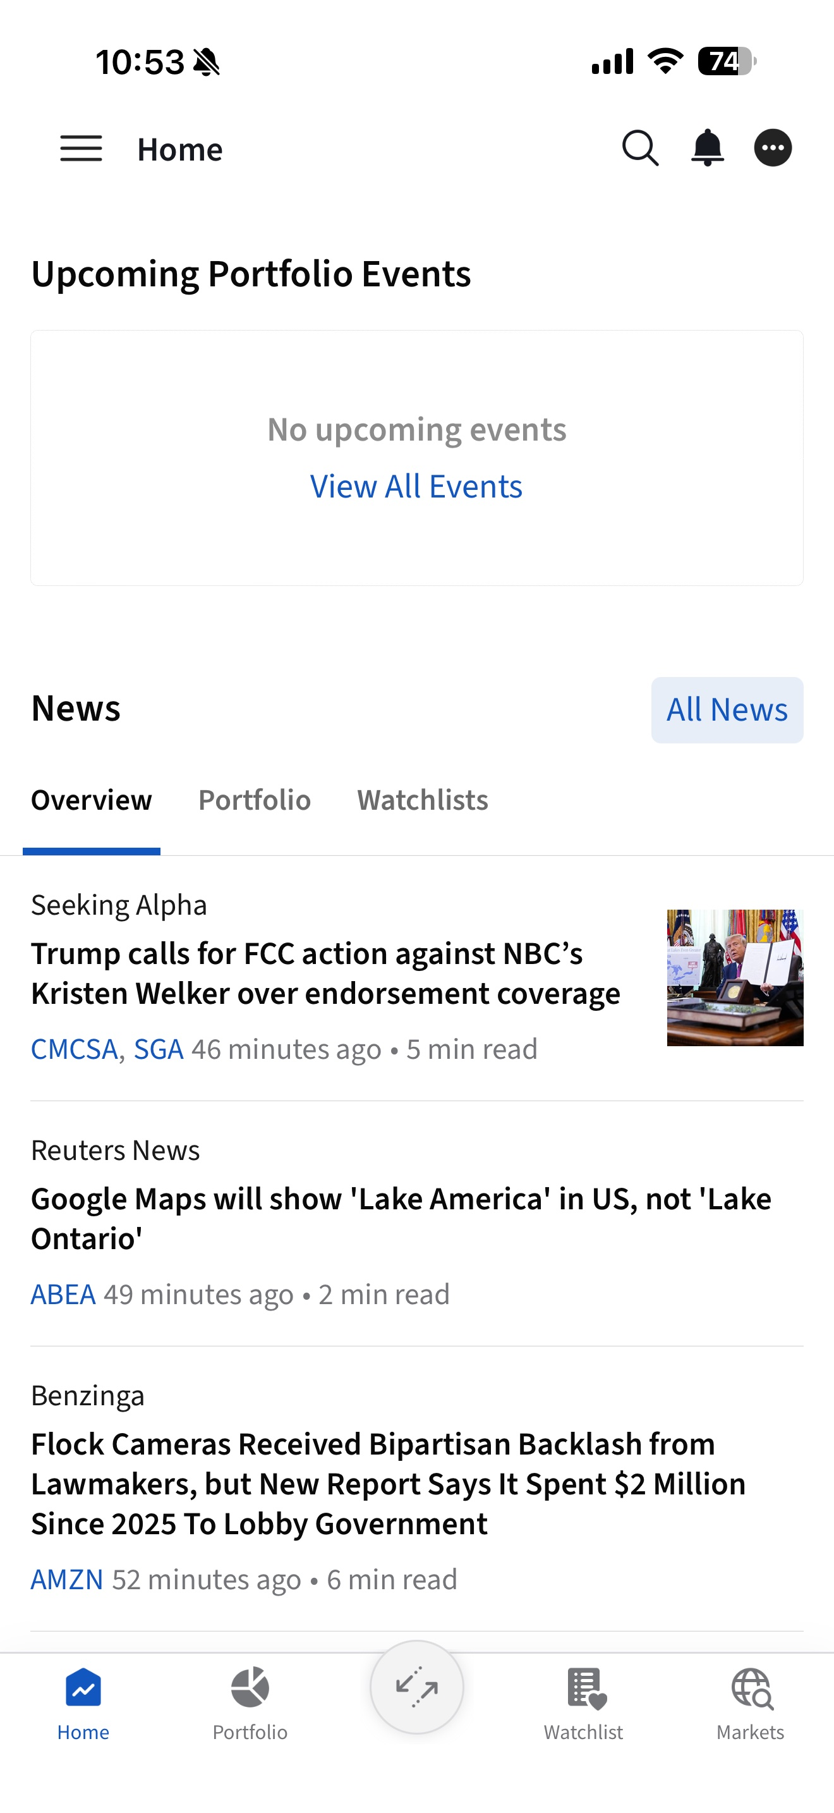
Home
Tab
The Home page provides a quick overview of the user's portfolio, account value, positions, upcoming events, and financial news.
Value | Performance: View your current account value and your portfolio performance over time.
Shortcut: Provides quick access to frequently used tools and functions.
Your Position: Provides an overview of your current holdings and performance. You can switch between tabs to view Daily P&L, Unrealized P&L, and Market Value.
Upcoming Portfolio Events: View scheduled events related to your portfolio.
News: View the latest market and investment news.
  Portfolio: View news related to your portfolio holdings.
  Watchlist: View news related to securities in your watchlist.

Slide 4
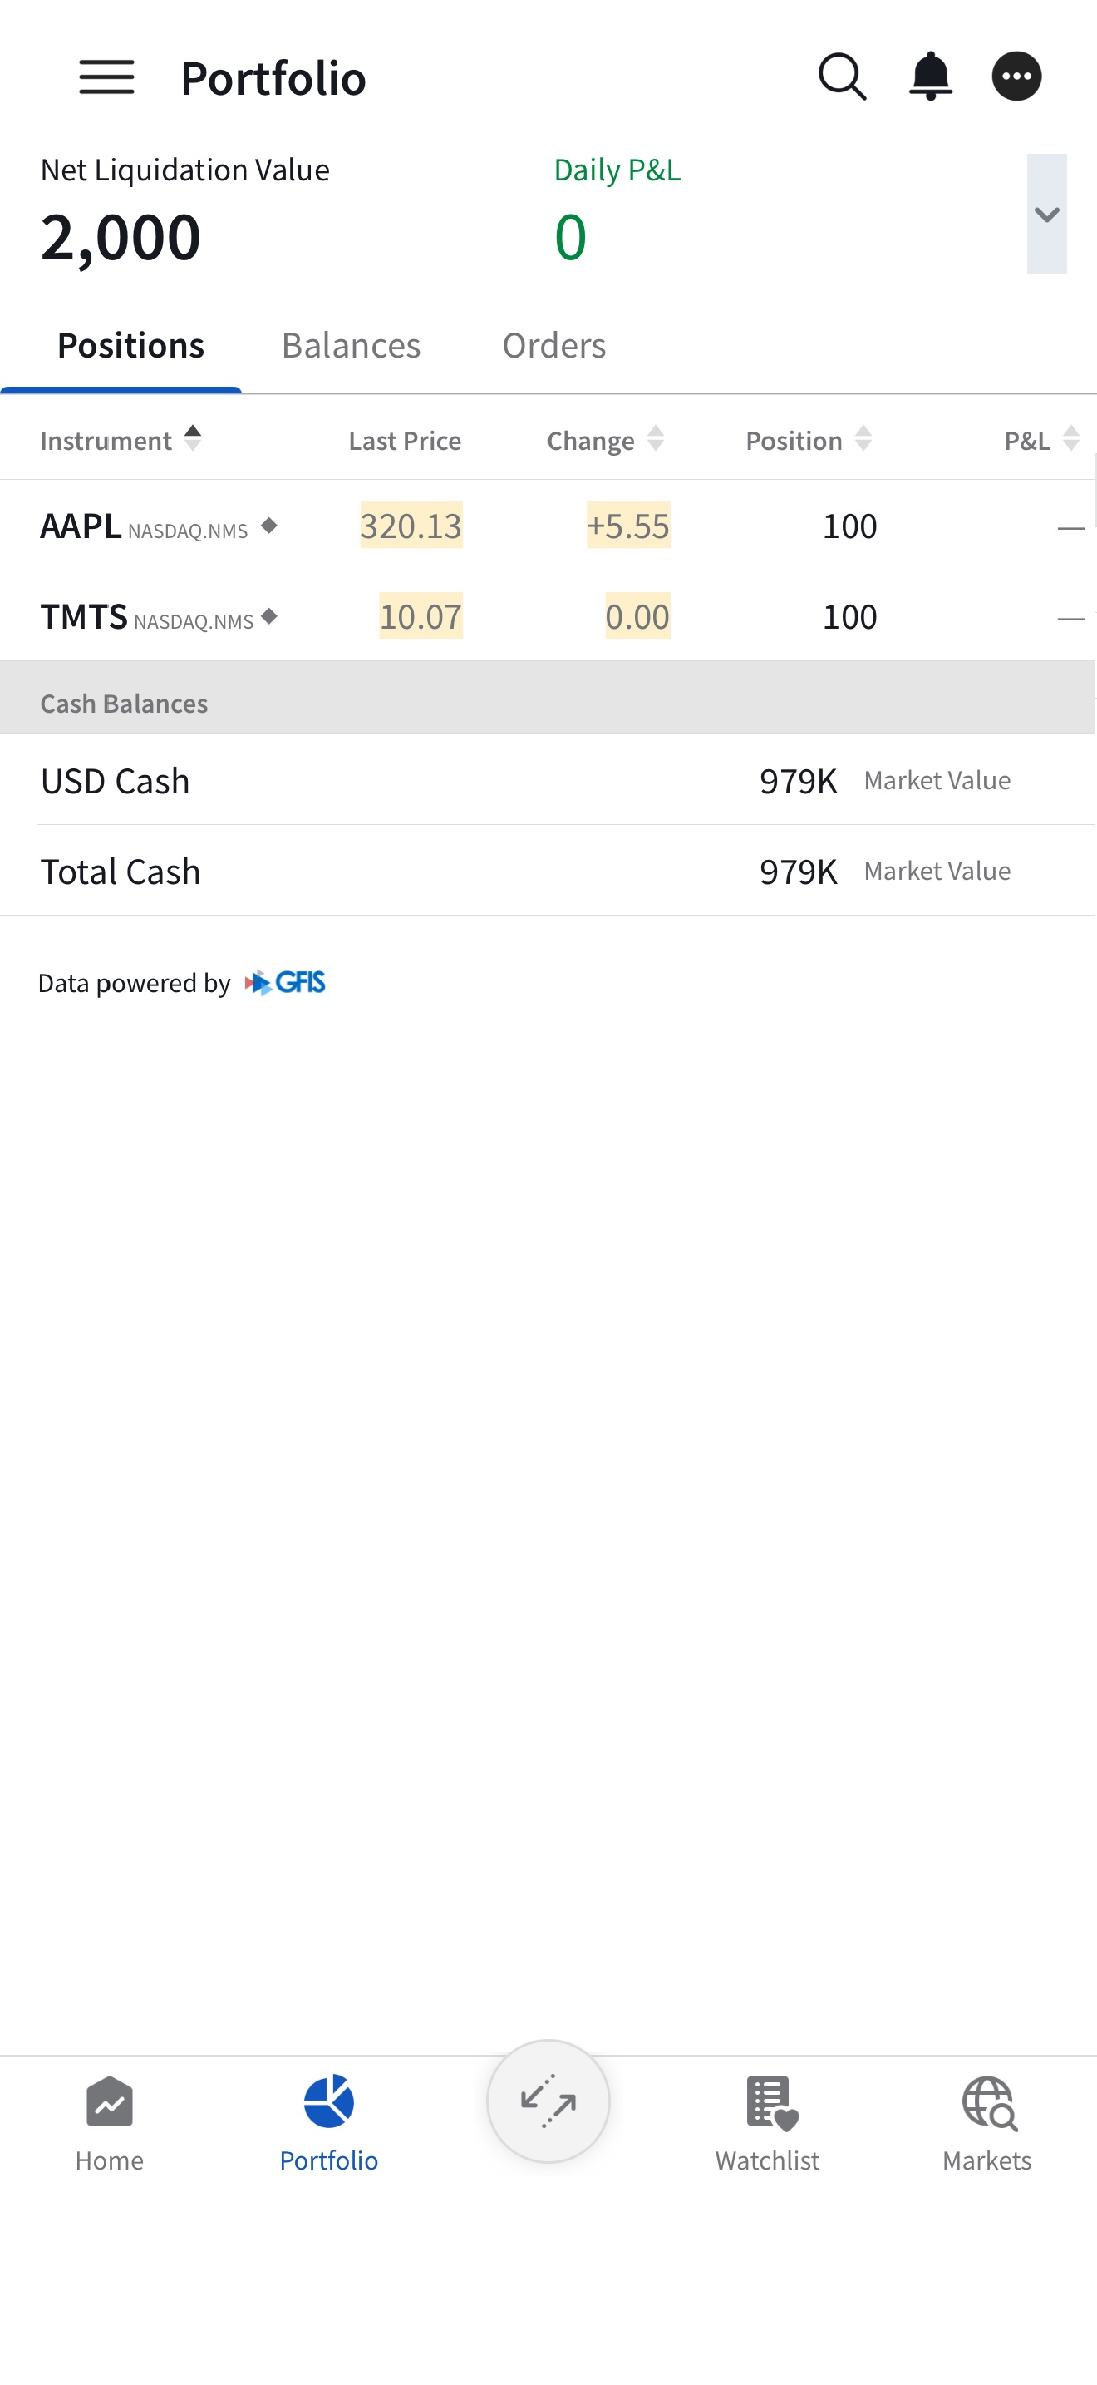
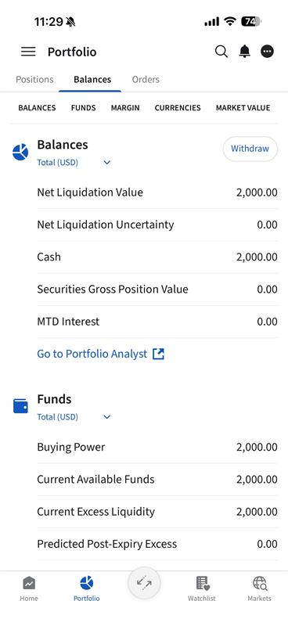
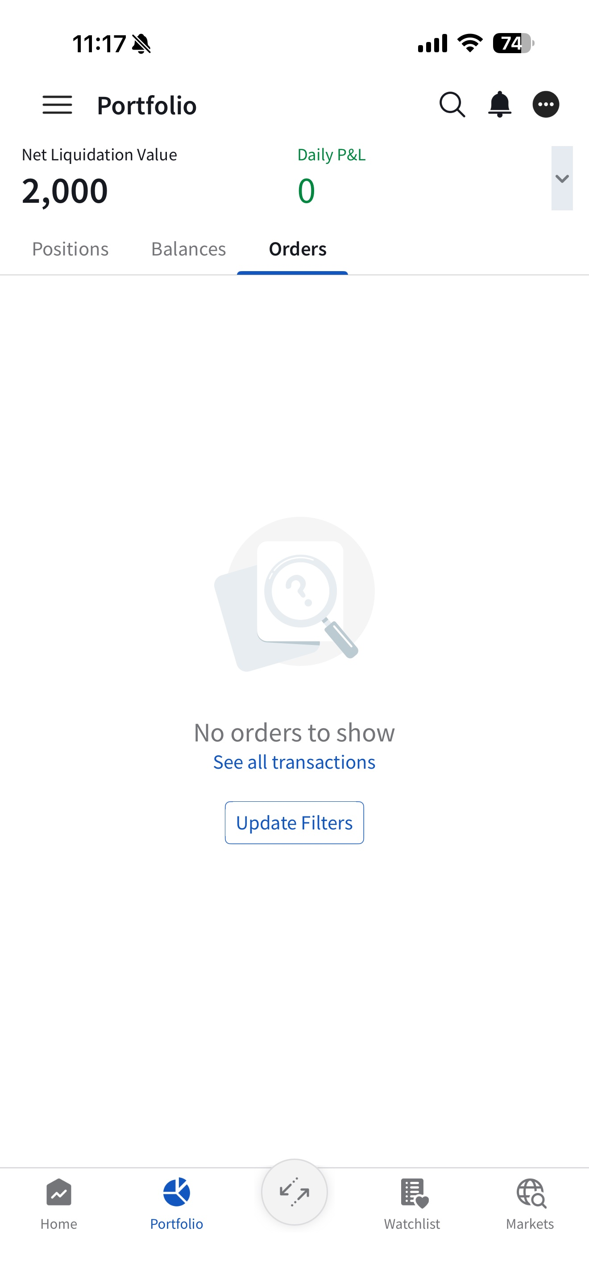
Portfolio
Tab
View your positions, account balances, margin information and orders.
Position: Provides an overview of your current holdings
Balance: View your account value, key info includes:
  Excess Liquidity: Your remaining margin cushion to maintain existing positions. If Excess Liquidity falls to zero or below, your positions may be subject to automatic liquidation.
  Net Liquidation: Total current value of your account, including cash and investments.
  Buying Power: Amount available for you to place trades.
  Initial Margin: Amount required to open a new position.
  Maintenance Margin: Amount required to maintain your existing positions.
Orders: View your order status and modify or cancel orders before they are filled.

Slide 5
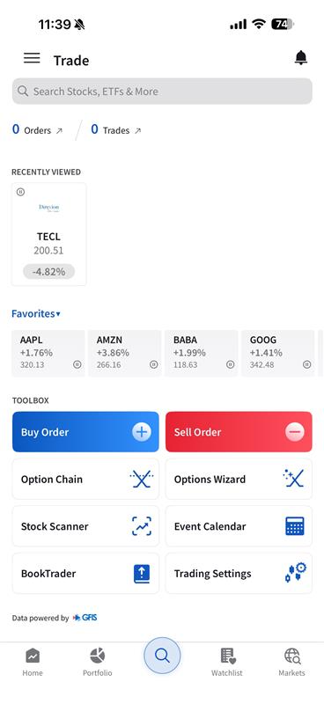
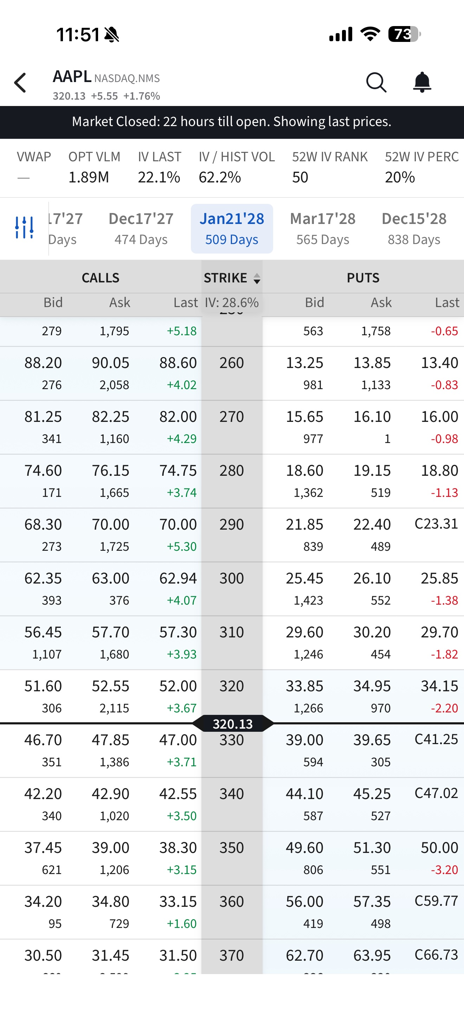
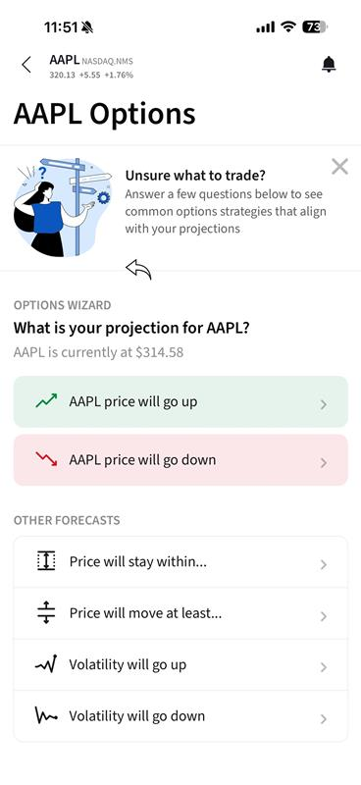
Trade
Tab
Access trading tools to place orders, view option chains and explore market opportunities.
Search: Search for stocks, ETFs and options
Orders: View your account value, key info includes:
Trades: View your executed trades.
Recently Viewed: Quickly access recently viewed products.
Favorites: Quickly access stocks in your watchlist.
Buy Order: Place a buy order.
Sell Order: Place a sell order.
Option Chain: View available option contracts by expiry and strike price.
Options Wizard: Find and build option strategies based on your market outlook.
Stock Scanner: Find stocks based on selected market criteria.
Event Calendar: View upcoming market and corporate events.
BookTrader: View market depth and place orders from the price ladder.
Trading Settings: Manage your trading and order settings.

Slide 6
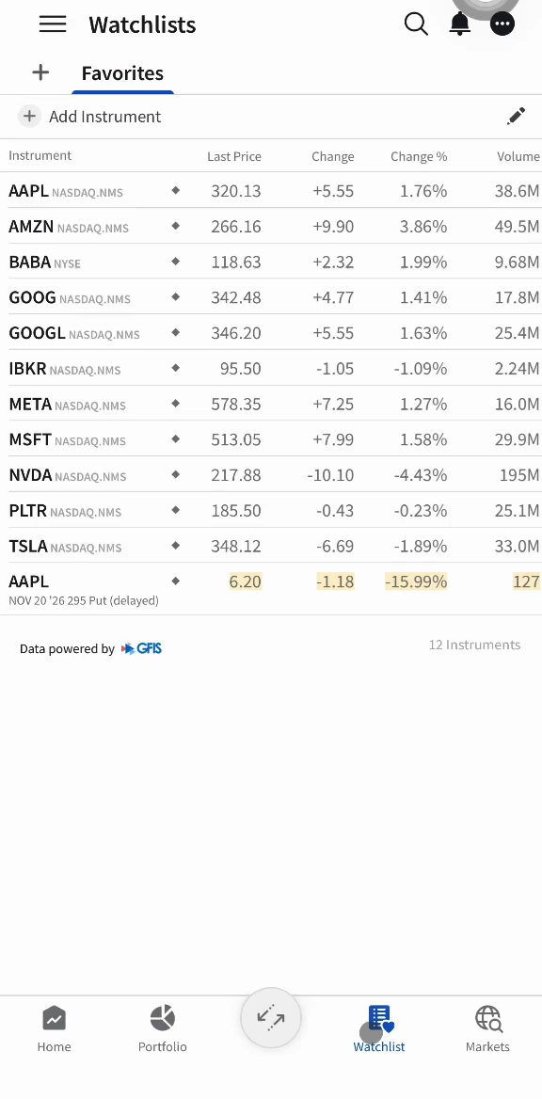
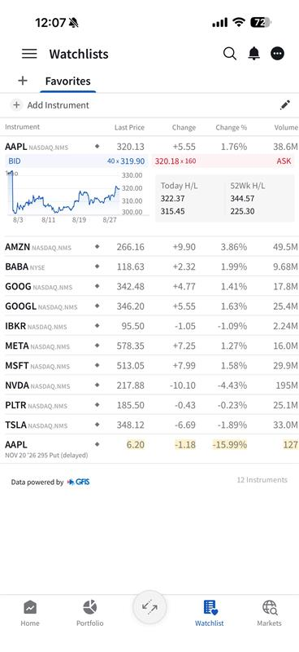
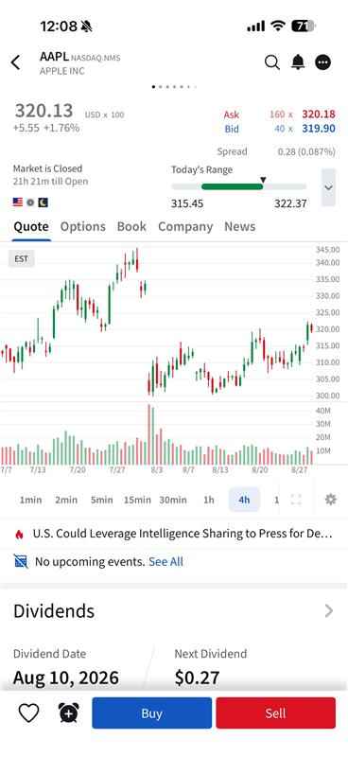
Watchlist
Tab
Monitor and quickly access stocks and options you are interested in. Tap a symbol to view a quick overview.
Add a New Watchlist
  Tap the “+” icon at the top of the screen.
  Enter your preferred watchlist name, then tap Save.
Edit a Watchlist
  Tap the pencil icon to edit your watchlist.
  Drag and drop symbols to rearrange their order.
  Select the symbol(s) you want to remove or save to another watchlist.
  Tap Save to apply the changes.
Add a New Symbol
  Search for the stock you are interested in and tap the heart icon.
  Select an existing watchlist, then tap Save.
  Alternatively, to save to a new watchlist, tap New, enter your preferred watchlist name, then tap Create Watchlist.

Slide 7
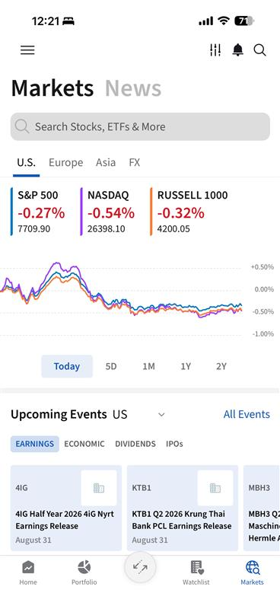
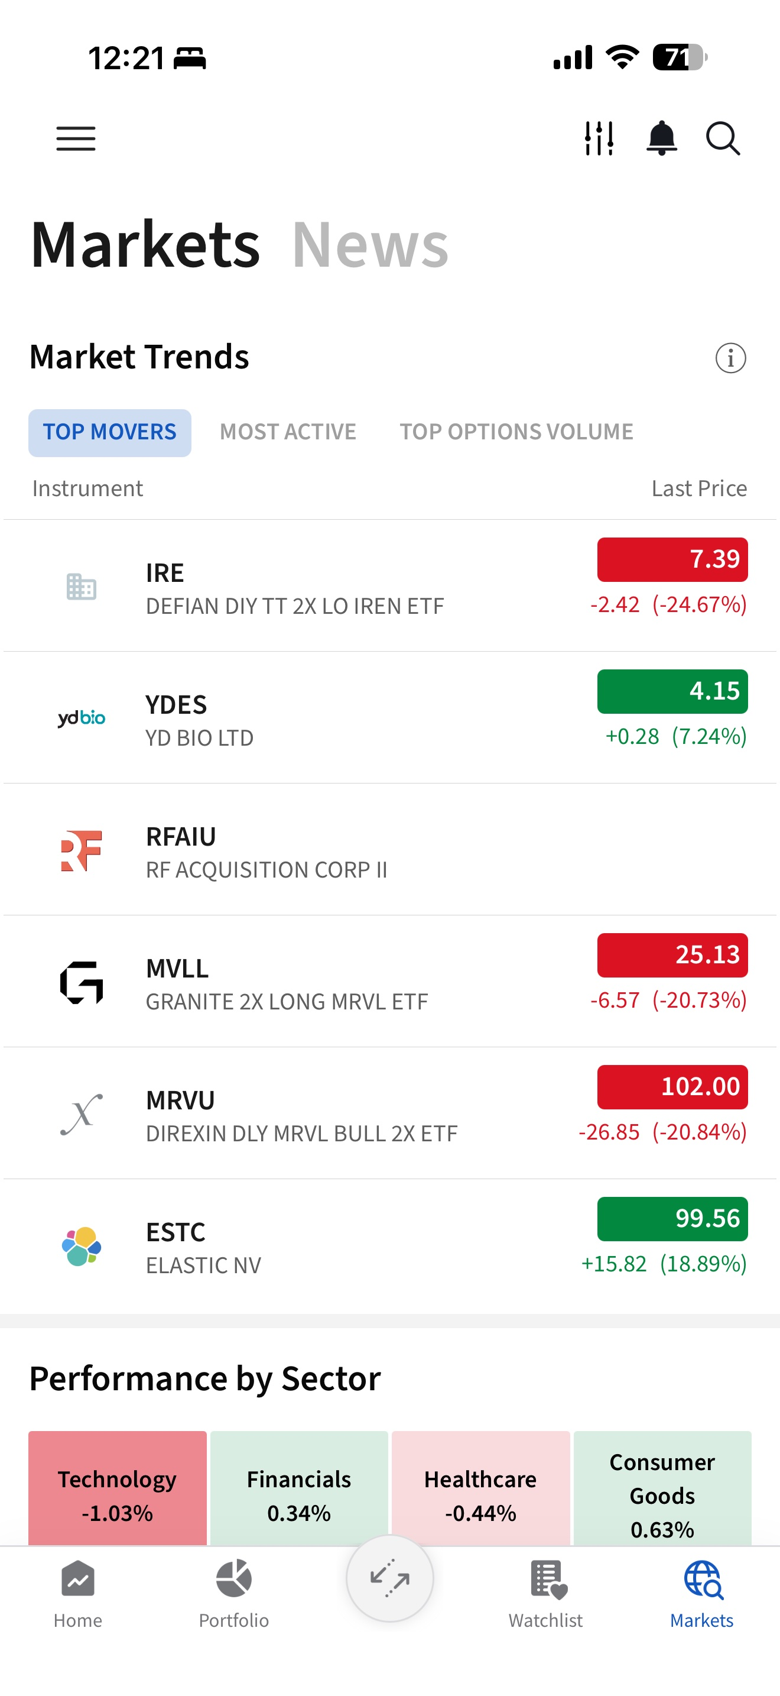
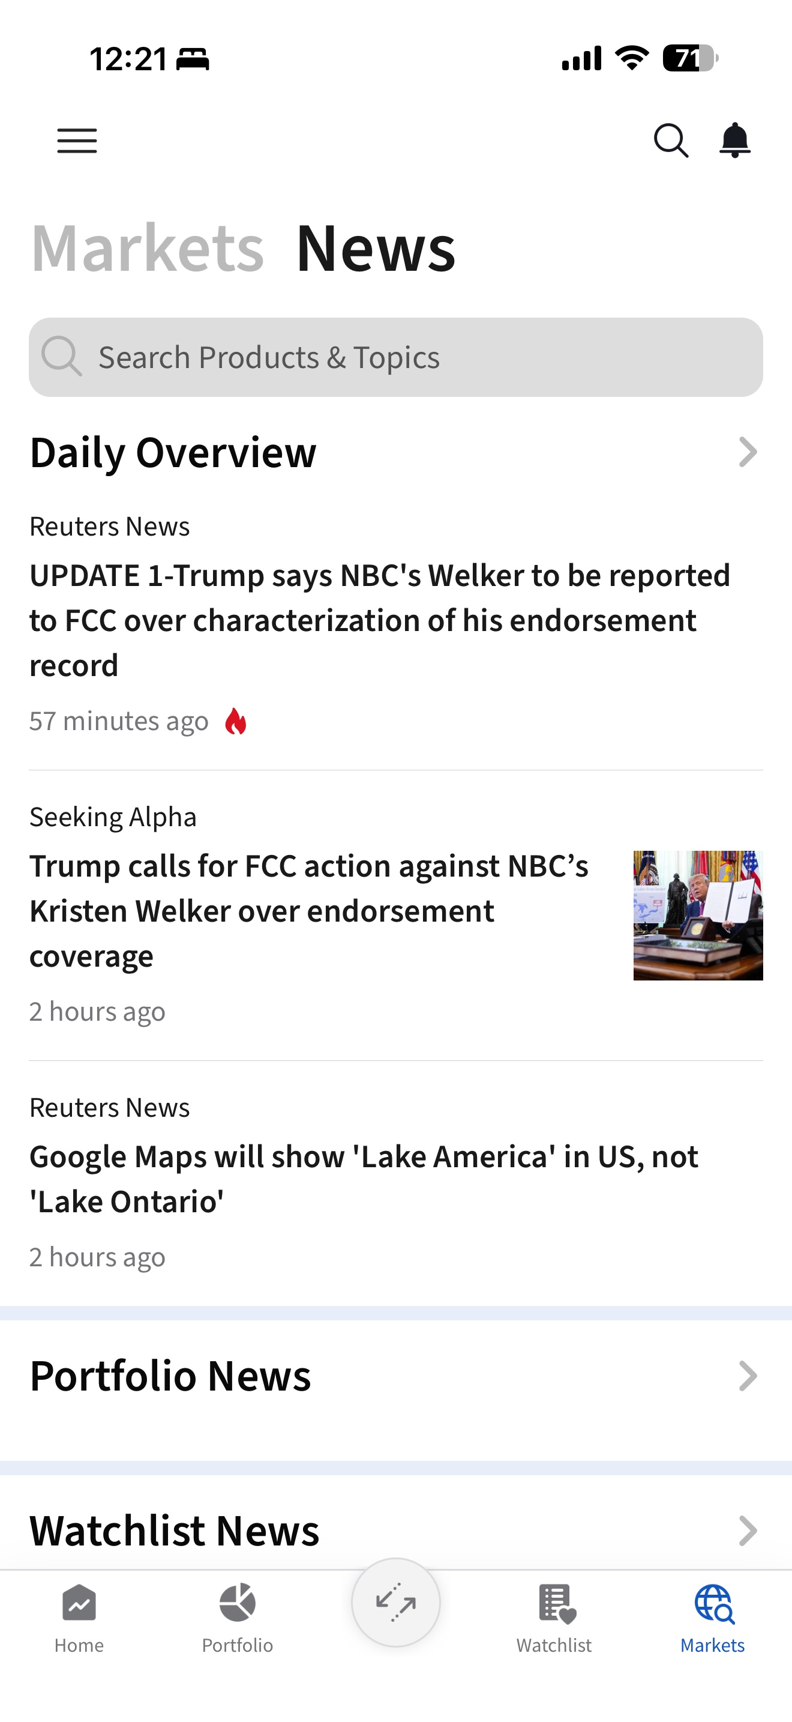
Markets
Tab
Stay updated on market performance, trends, upcoming events and the latest market news.
Markets
Overview – View the performance of major market indices across U.S., Europe, Asia and FX, with charts across different time periods.
Upcoming Events – Keep track of upcoming earnings, economic events, dividends and IPOs.
Market Trends – Discover market activity by viewing Top Movers, Most Active and Top Options Volume.
Performance by Sector
Quickly compare the performance of different market sectors.
News
Daily Overview – View the latest general market news and developments.
Portfolio News – View news related to securities held in your portfolio.
Watchlist News – View news related to securities added to your watchlists.

Slide 8
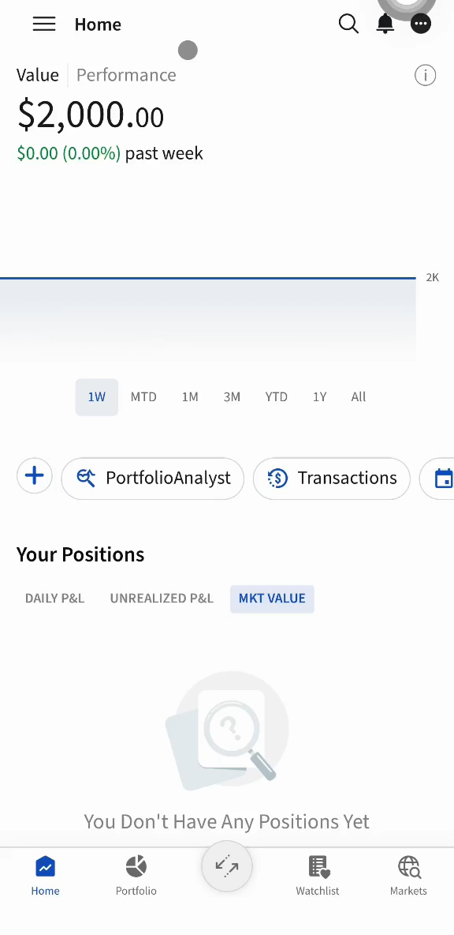
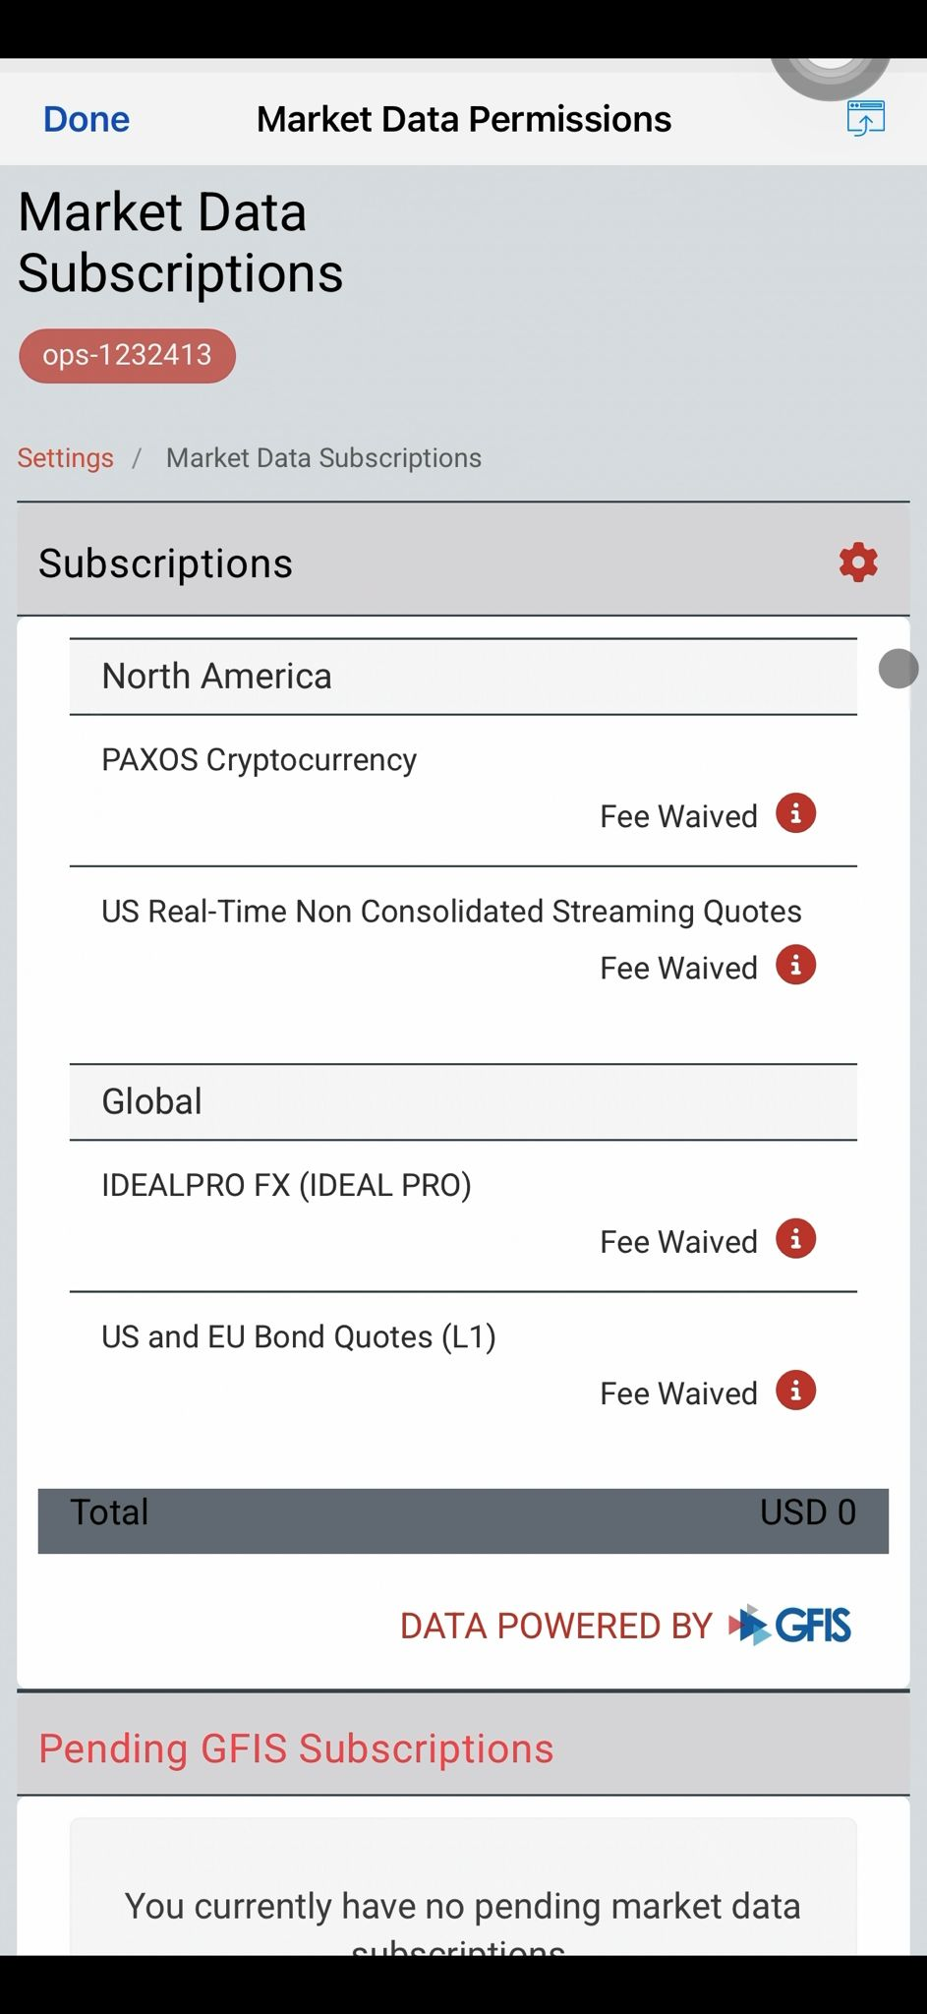
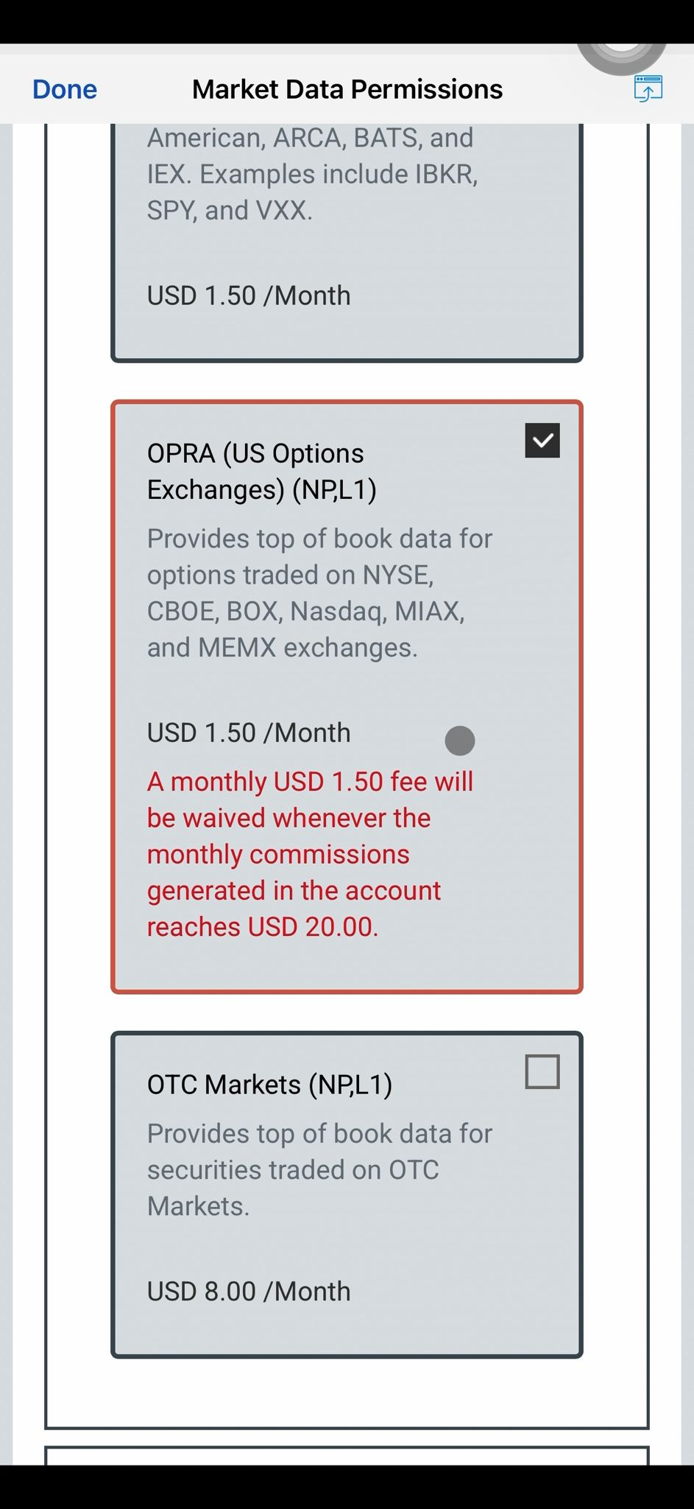
How do I subscribe to live options chains?
Subscription
Tap the triple-bar icon to open the menu.
Tap “Settings”.
Select “Account Settings”.
Tap “Market Data Subscriptions”.
Under Subscriptions, tap the gear icon to configure your subscriptions.
Scroll down and locate “Level I (NBBO)”.
Locate “OPRA (US Options Exchanges)”and check the box,
Scroll to the bottom, then tap “Continue”.
Follow the on-screen instructions to complete the subscription.

Slide 9
Options Wizard
Whether you are new to options trading or exploring different strategies, the Options Wizard helps simplify the process. Simply answer a few questions on your market outlook, and the system will suggest strategies that align with your expectations.
Explore Strategies
Based on your price or volatility outlook, the Options Wizard will generate a list of potential strategies. You may further filter the results by criteria such as probability of profit, debit/credit strategies, and premium levels.

Slide 10
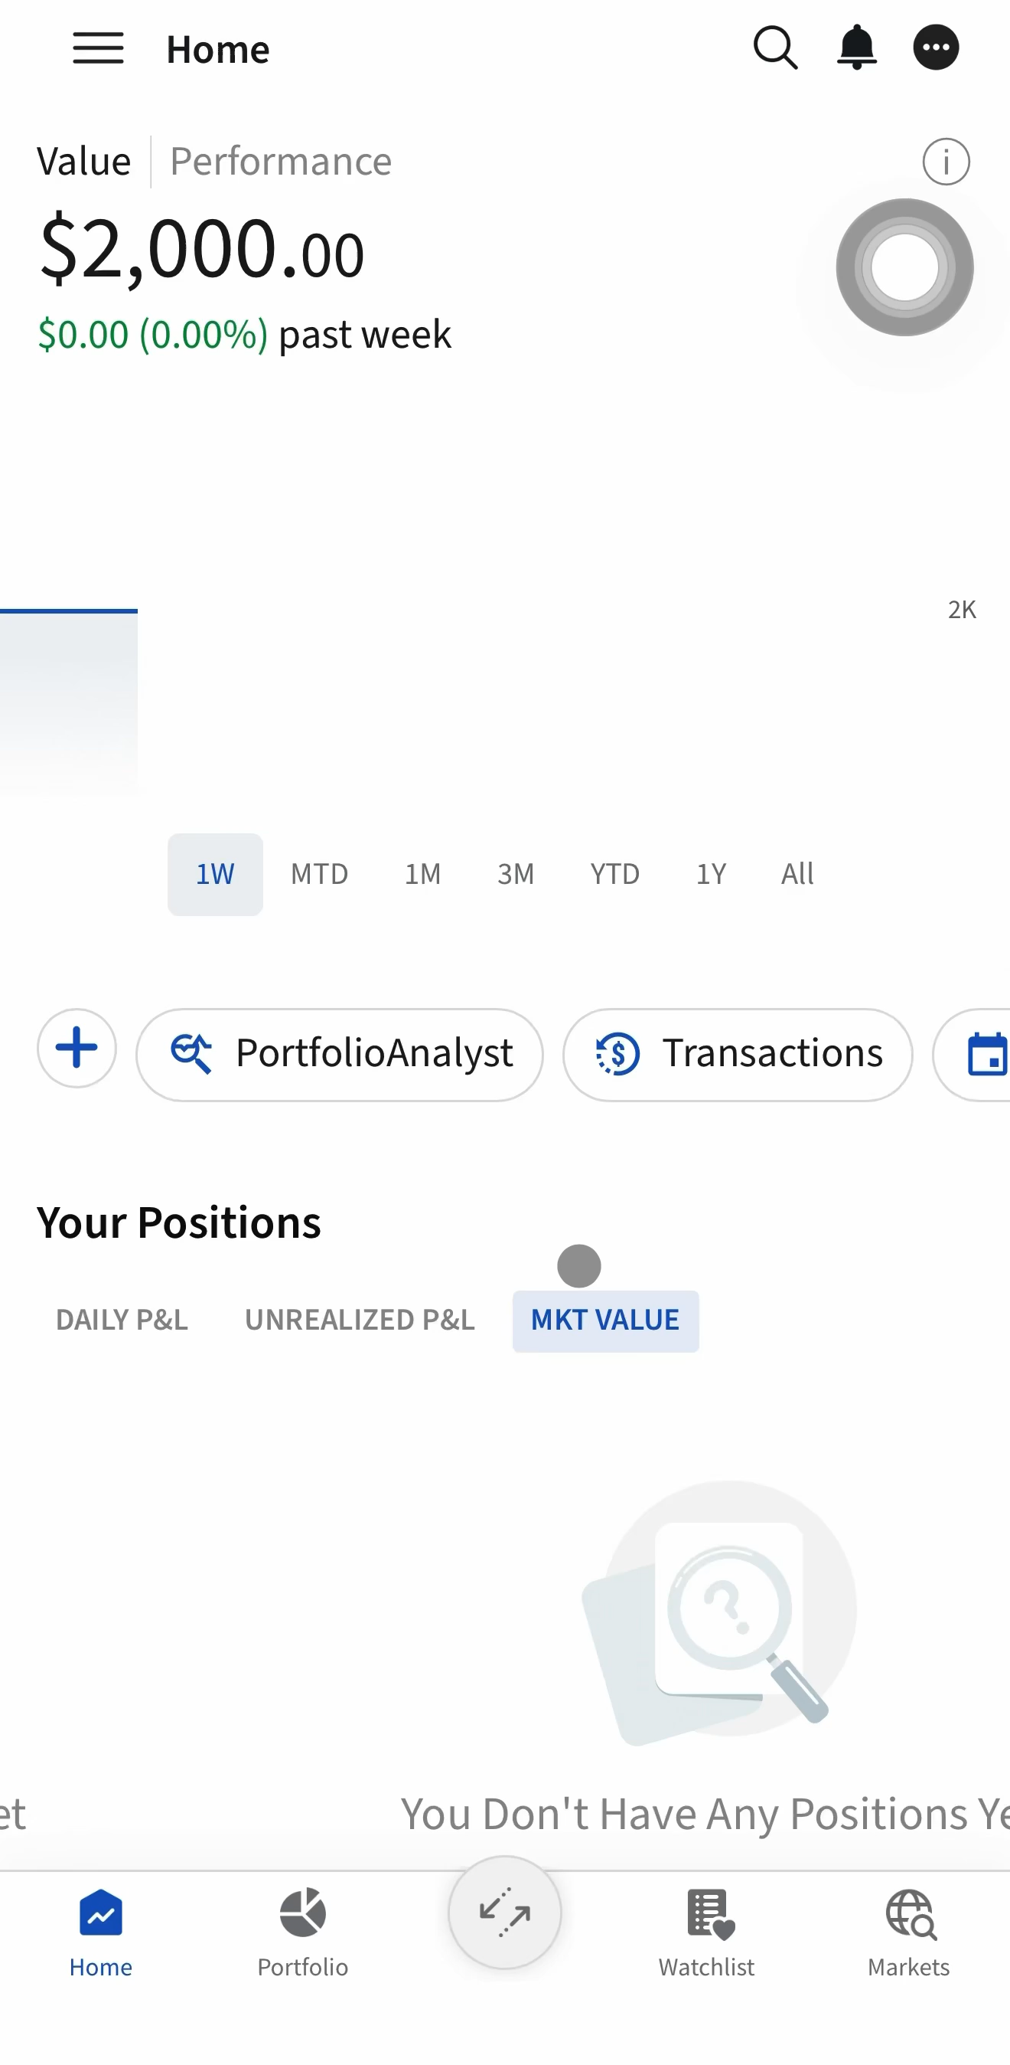
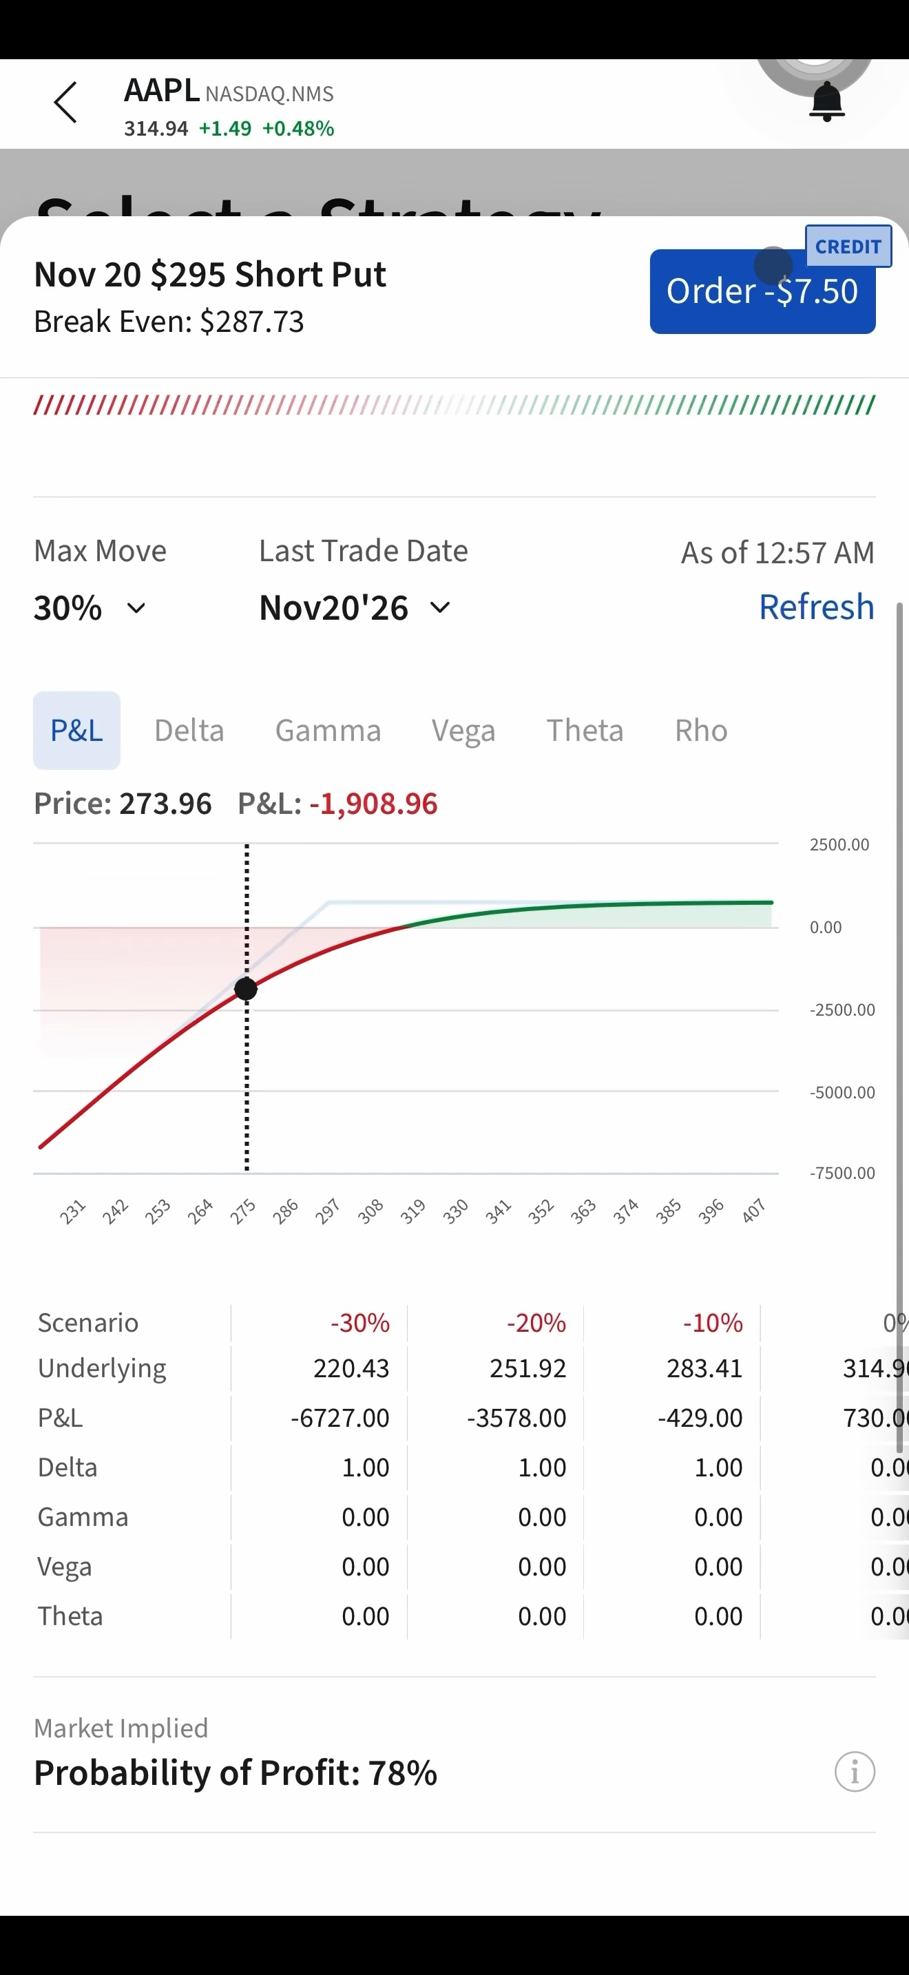
How to use the Options Wizard?
Trade
Tap “Trade” > “Options Wizard”
Enter the symbol of the underlying stock
Tap the “Options Wizard” to begin building an options strategy.
Select your forecast for the underlying stock’s price movement.
Tap “Find Strategies”
Select the time horizon based on when you expect the stock price to reach your forecast.
Enter the expected increase or decrease in the stock price, either as a percentage or dollar value, then tap “Next”.
Select your preferred strategy to view the strategy details.
Tap “Orders” to proceed with placing an order.
Enter the order details, such as Quantity, Order Type, Price, and Expiry.
Swipe to Buy/Sell to submit the order.

Slide 11
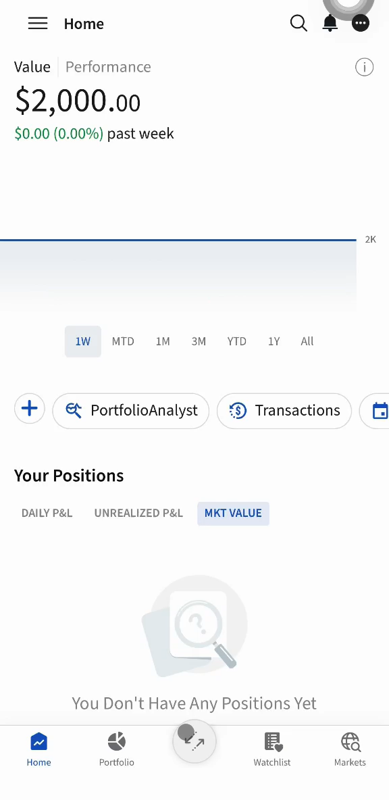
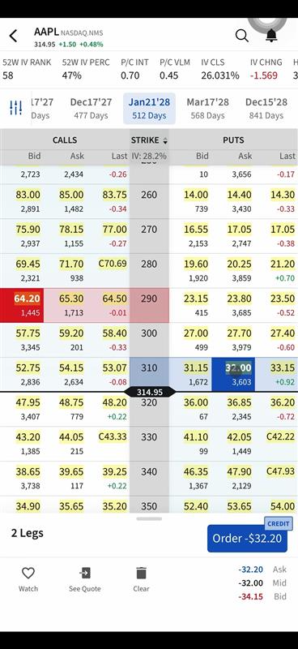
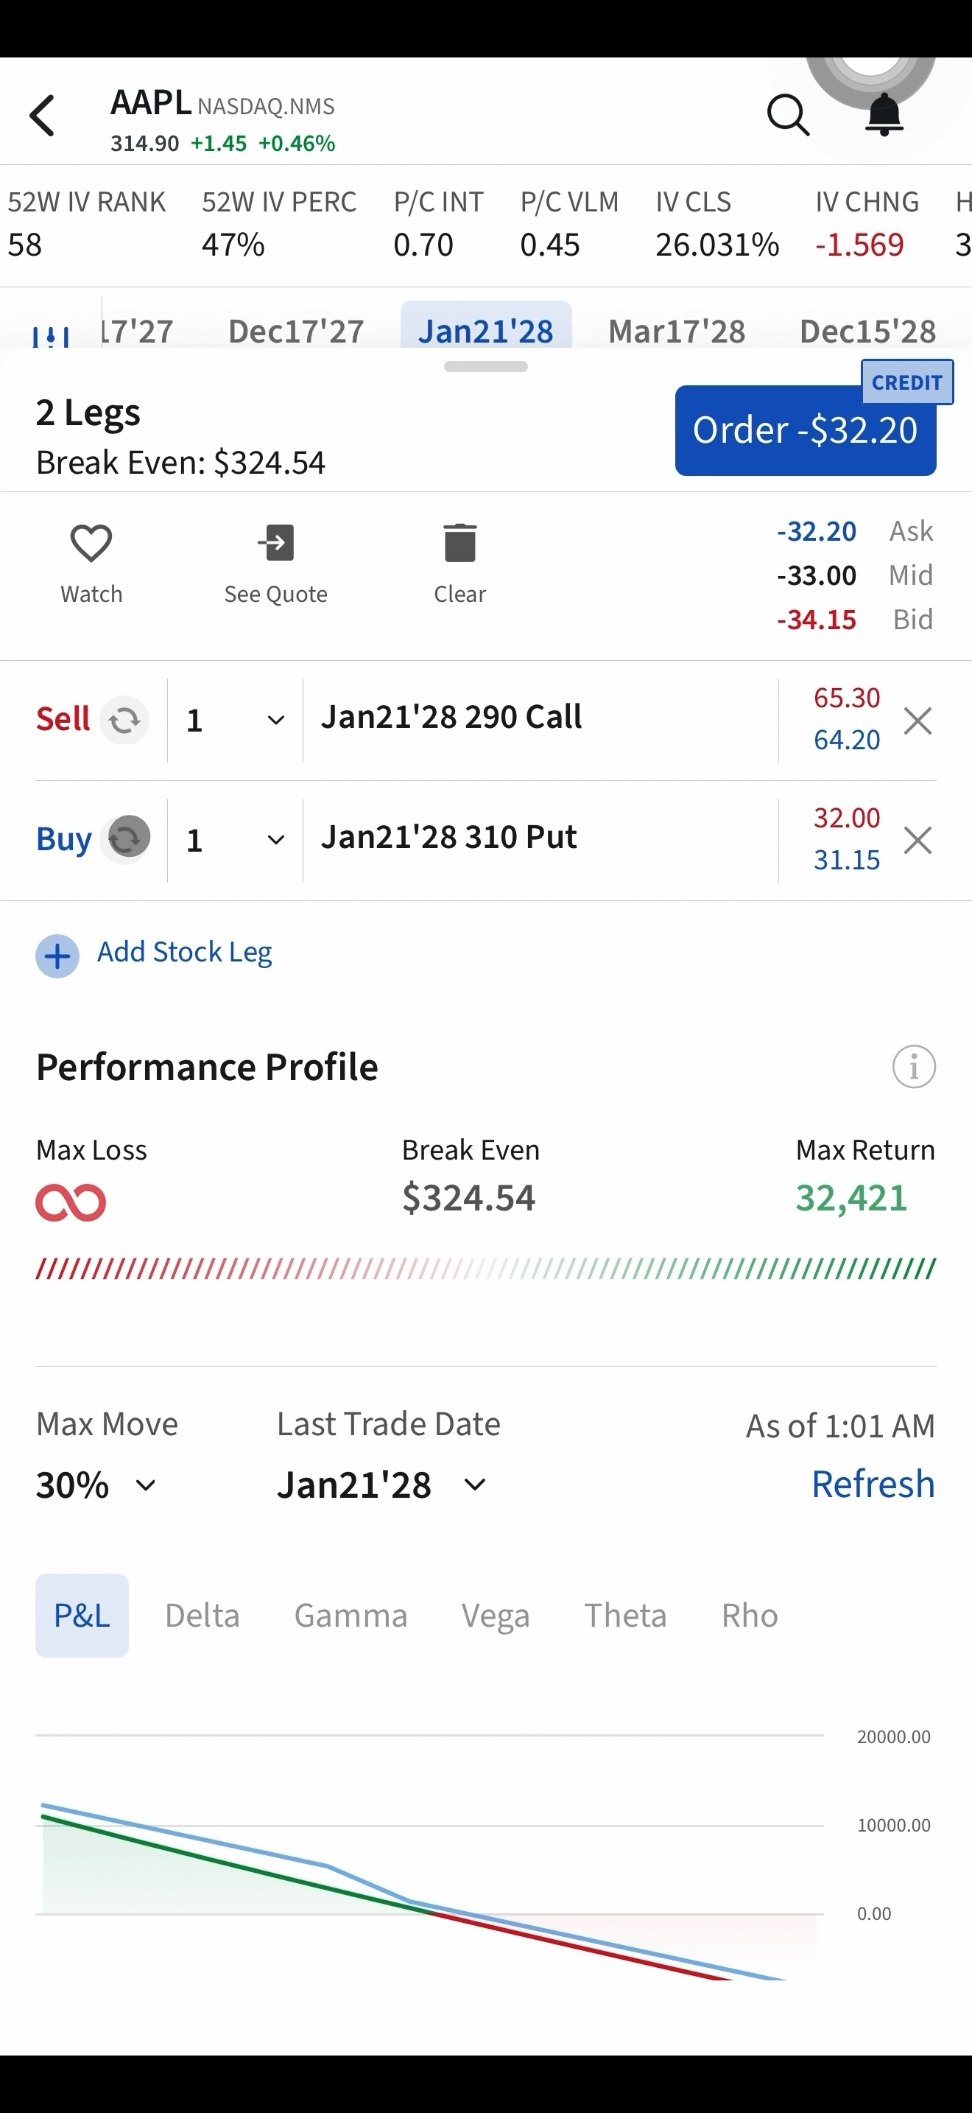
How to trade using the Options Chain?
Trade
Tap “Trade” > “Options Chain”.
Enter the symbol of the underlying stock.
Tap the “Option Chain & Strategy Builder”.
Scroll through the expiration dates and select your preferred expiration date.
Scroll up or down to view the available strike prices.
Select the option you wish to trade
  To buy: Click the Ask Price
  To sell: Click the Bid Price
  Select multiple to create a multi leg strategies
Swipe up the drawer to view strategy details, such as the P&L diagram and Greeks.
Review the strategy details and, if required, change the direction (Buy/Sell) or remove individual legs.
Tap “Orders” to proceed with placing an order.
Enter the order details, such as Quantity, Order Type, Price, and Expiry.
Swipe to Buy/Sell to submit the order.

Slide 12
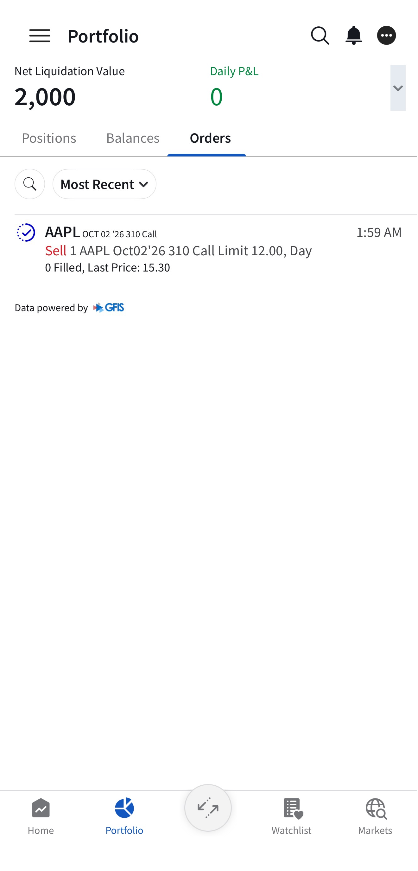
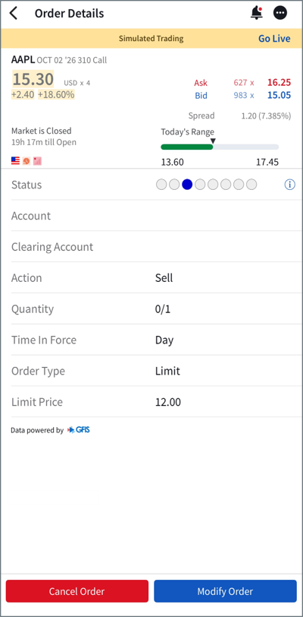
How do I amend or cancel an options order?
Trade
Tap “Portfolio” > “Orders”.
Select the order you would like to modify or cancel.
Select “Modify Order” or “Cancel Order”.
  Modify Order: Update the order details, then swipe to Buy/Sell to submit the modified order.
  Cancel Order: Tap “Cancel Order” to cancel the order.

Slide 13
Thank you
Contact
83 Clemenceau Avenue, #10-01, UE Square
Singapore 239920
info@uobkh.com
uobkh.com

