Slide 1
Options
Platform Guide
Version: 250826

Slide 2
Table of Contents
Options – User Guide
Page
  Home
    Home - Balances
  Trade
  Research
  Performance & Reports
Trade
  How do I use the Options Wizard?
  How do I place an options order?
  How do I amend or cancel an order?
Watchlist
  How do I create a new Watchlist?
  How do I delete an existing Watchlist?
  How do I add symbol to my watchlist?
  How do I delete symbol from my watchlist?

Slide 3
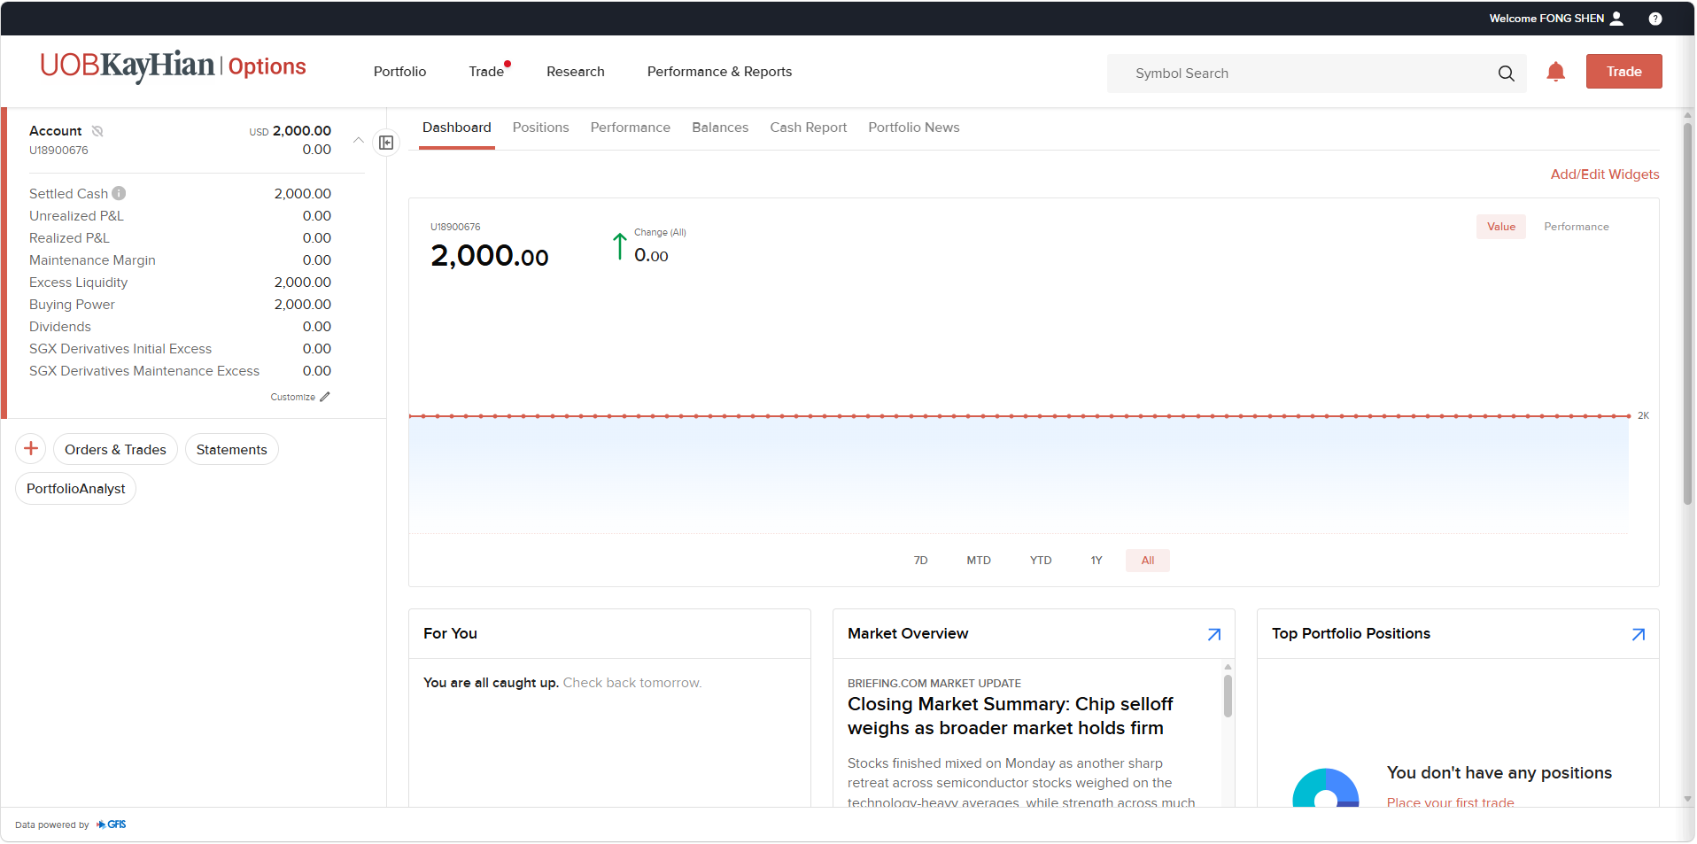
Home
Page
Dashboard: Overview of your account and portfolio.
Positions: View your current holdings and open positions.
Performance: Track your portfolio performance over time.
Balances: View account balances, margin requirements and trading limits.
Portfolio News: View news relevant to your portfolio.
Quick Link:
Orders & Trades: View and manage your orders and executed trades.
Statement: View and download your account statements and reports.
PortfolioAnalyst: View detailed portfolio performance and analytics.
Events: View upcoming events related to your portfolio and investments.
News: View the latest market and investment news.

Slide 4
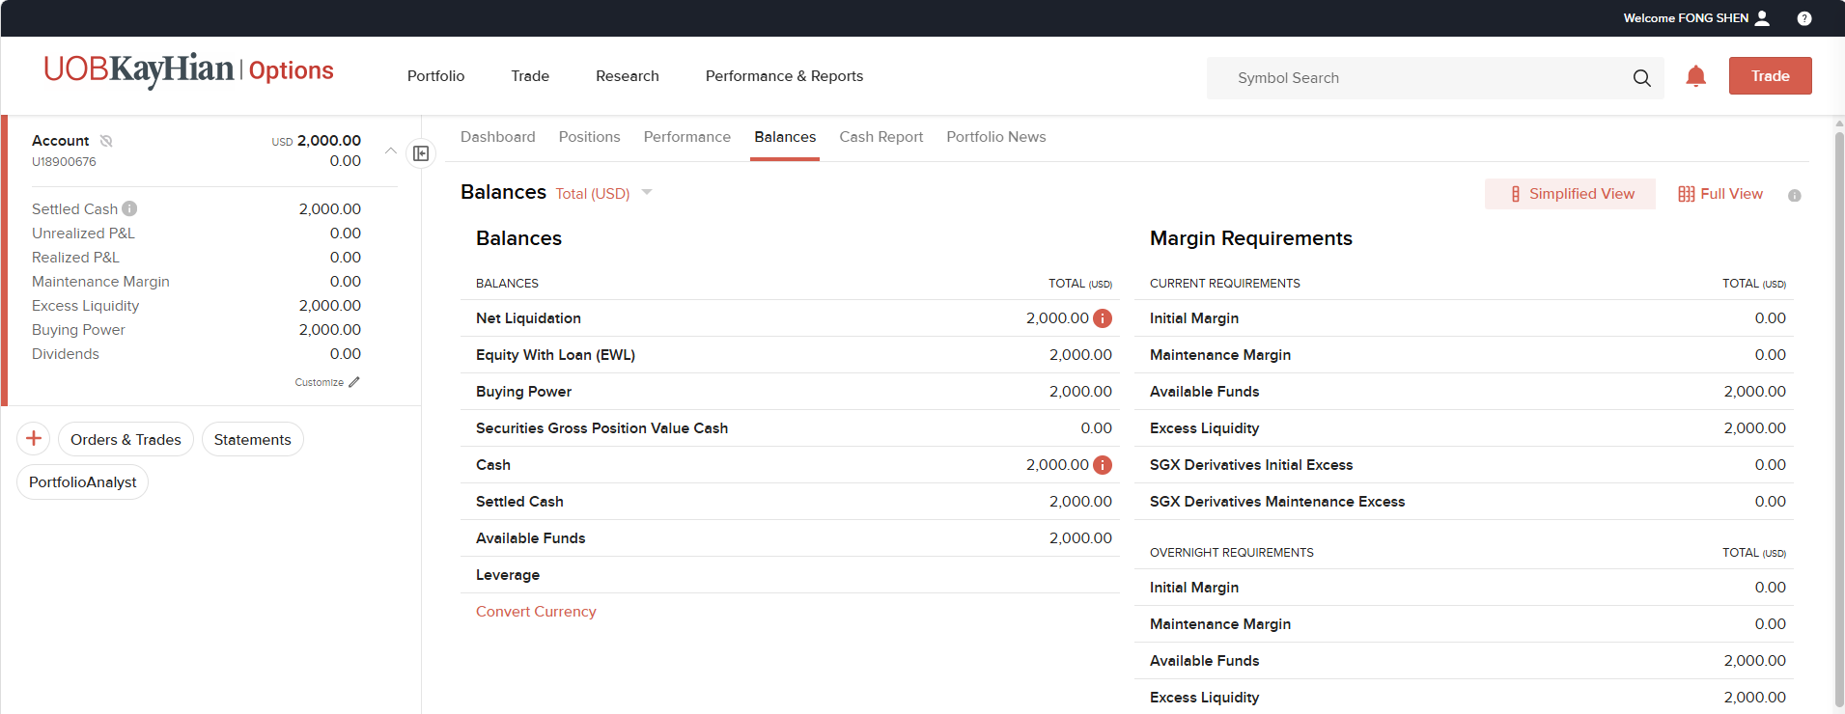
Home - Balances
Page
Excess Liquidity: Your remaining margin cushion to maintain existing positions. If Excess Liquidity falls to zero or below, your positions may be subject to automatic liquidation.
Net Liquidation: Total current value of your account, including cash and investments.
Buying Power: Amount available for you to place trades.
Initial Margin: Amount required to open a new position.
Maintenance Margin: Amount required to maintain your existing positions.
Note: IM and MM requirements are determined by OCC and our execution partner based on its portfolio margin methodology.

Slide 5
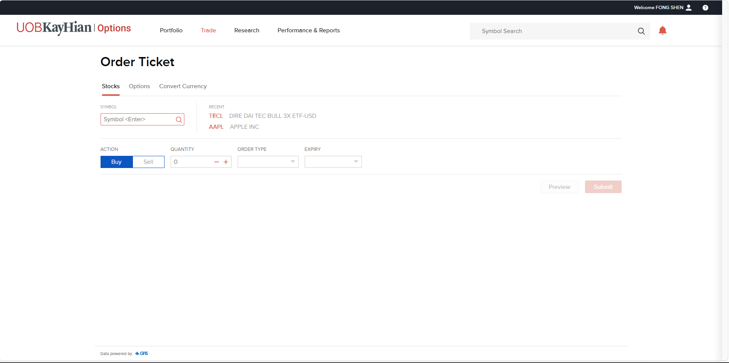
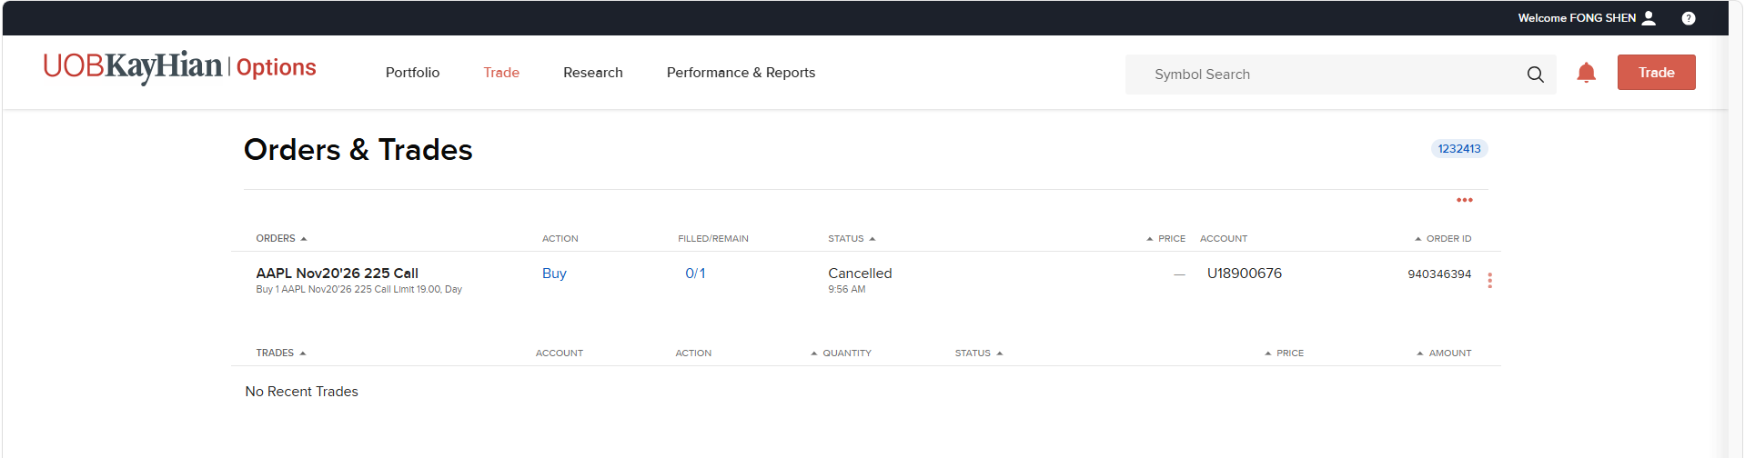
Trade
Page
Place and manage your stock and options orders.
Order Ticket
To place stock and options orders.
Orders & Trades
To view, modify or cancel orders and view recent trades.
Refer to the following slides for more details.
How do I place an options order?
How do I amend or cancel an order?
How do I use the Options Wizard?

Slide 6
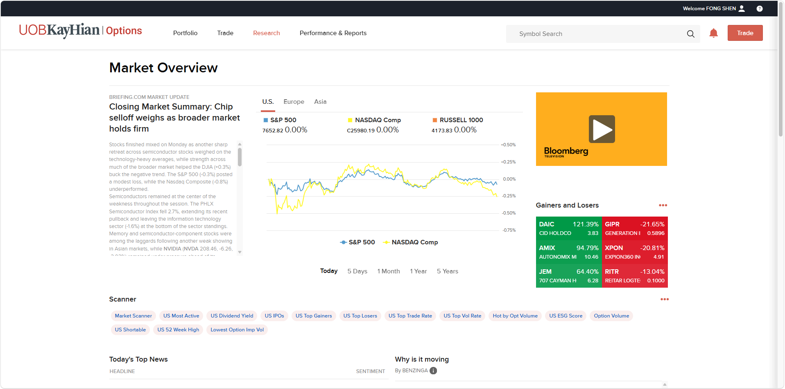
Research
Page
Watchlist: Monitor selected stocks and options
Market Screener: Find stocks based on selected criteria and filters.
Fundamentals Explorer: View company fundamentals, financial data and key metrics.
Market Overview: View an overview of market performance and trends.
News & Research: Access market news, research and analysis.
Events Calendar: View upcoming market and company events.
Exchange Notices: View notices and updates from exchanges.

Slide 7
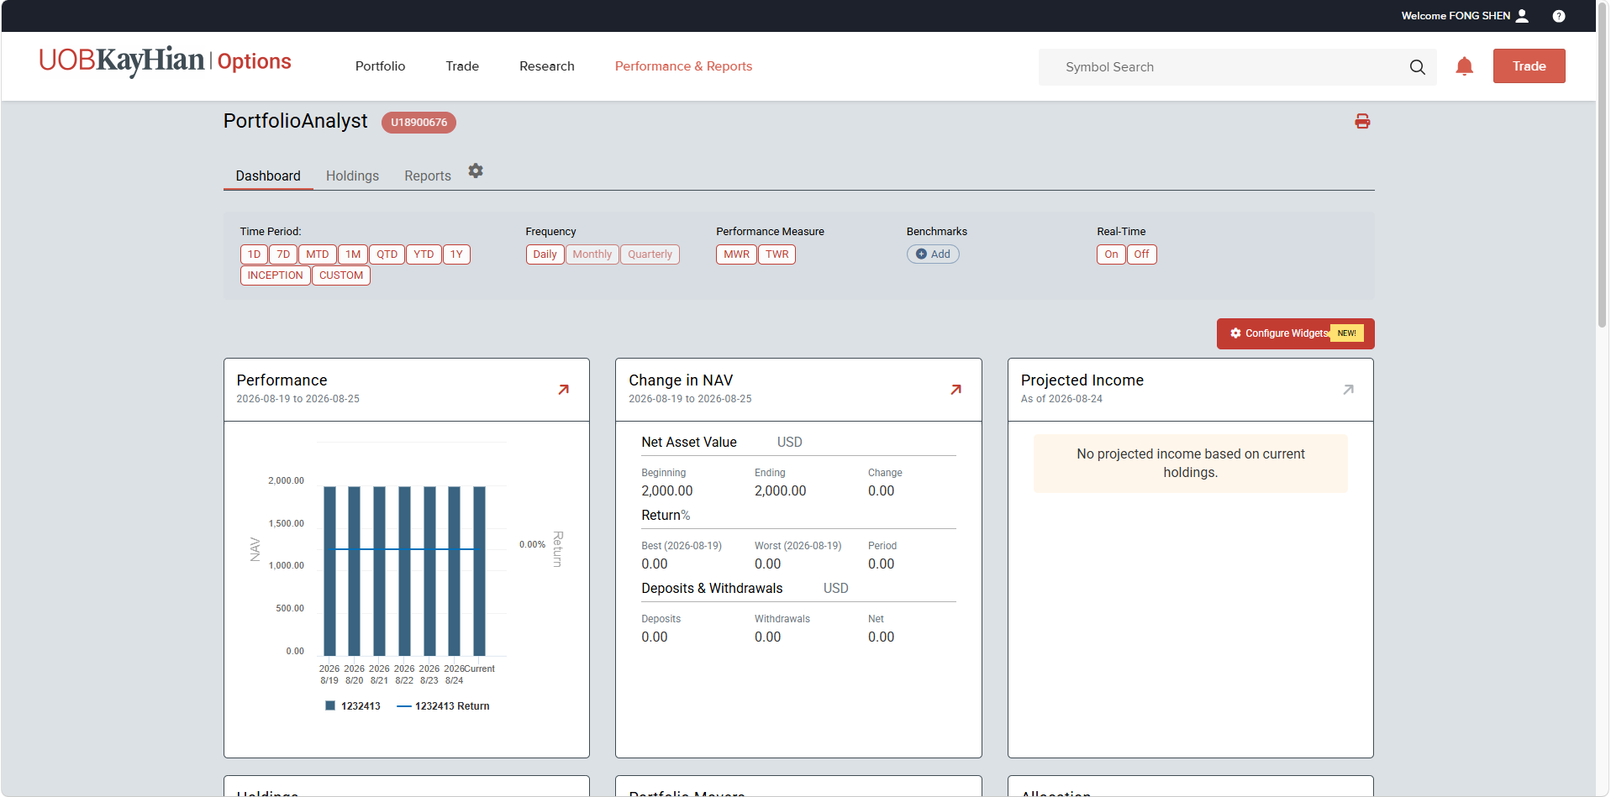
Performance & Reports
Page
PortfolioAnalyst: Analyse portfolio performance and create detailed performance reports.
Statements: View and generate account statements and trade confirmation reports.
Flex Queries: Create customised activity or trade reports in CSV, Text or XML format.
Other Reports: Access additional reports.
Transaction History: View the history and status of account transactions.

Slide 8
Options Wizard
Whether you are new to options trading or exploring different strategies, the Options Wizard helps simplify the process. Simply answer a few questions on your market outlook, and the system will suggest strategies that align with your expectations.
Explore Strategies
Based on your price or volatility outlook, the Options Wizard will generate a list of potential strategies. You may further filter the results by criteria such as probability of profit, debit/credit strategies, and premium levels.

Slide 9
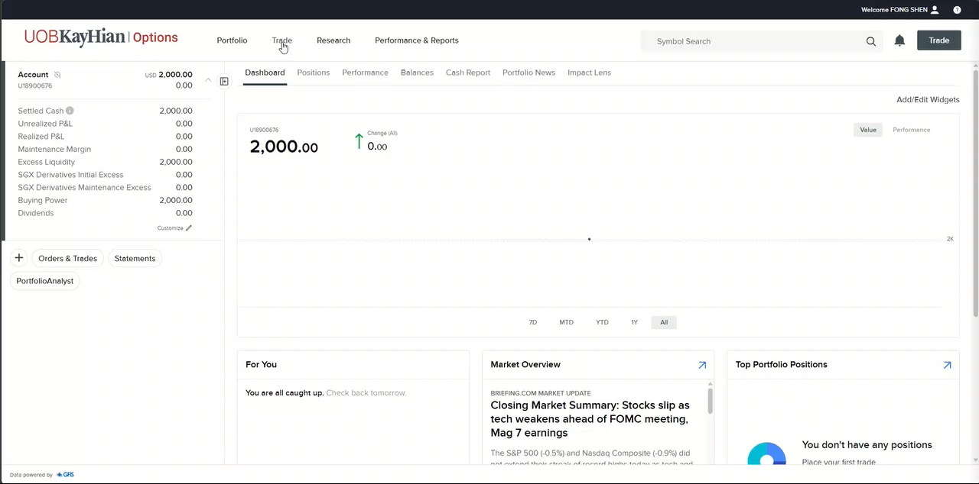
How do I use the Options Wizard?
Trade
Click on “Trade” > “Order Ticket”
Select “Options”
Click “Options”, enter the symbol of the underlying stock and press “Enter”
Click on “View Options Wizard”
Click on your projection.
Click “Find Strategies”
Select the time horizon based on when you expect the stock price to reach your forecast
Enter the expected percentage or value (USD) increase or decrease in the stock price, then click “Next”.
Select your preferred strategy
Enter the order details, such as Quantity, Price and Expiry
Click “Buy Order” or “Sell Order” to submit the order
Note: 1 option contract typically represents 100 shares of the underlying stock.

Slide 10
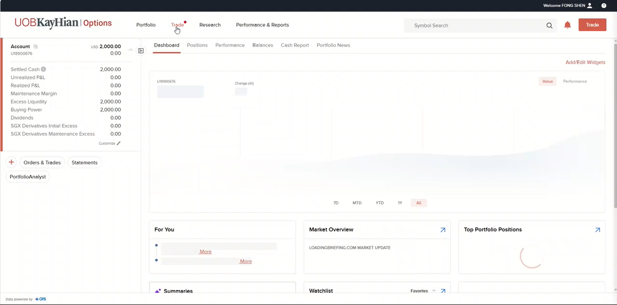
How do I place an options order?
Trade
Click on “Trade” > “Order Ticket”
Select “Options”
Click “Options”, enter the symbol of the underlying stock and press “Enter”
Click on “View Options Chain”
Scroll through the expiration dates and select your preferred expiration date.
Scroll up or down to view and select the available strike prices.
Select the option you wish to trade
  To buy: Click the Ask Price
  To sell: Click the Bid Price
  Select multiple to create a multi leg strategies
Review your order
Click “Order” to proceed to the order ticket.
Enter the order details, such as Quantity, Price and Expiry.
Click “Buy Order” or “Sell Order” to submit the order.
Note: 1 option contract typically represents 100 shares of the underlying stock.

Slide 11
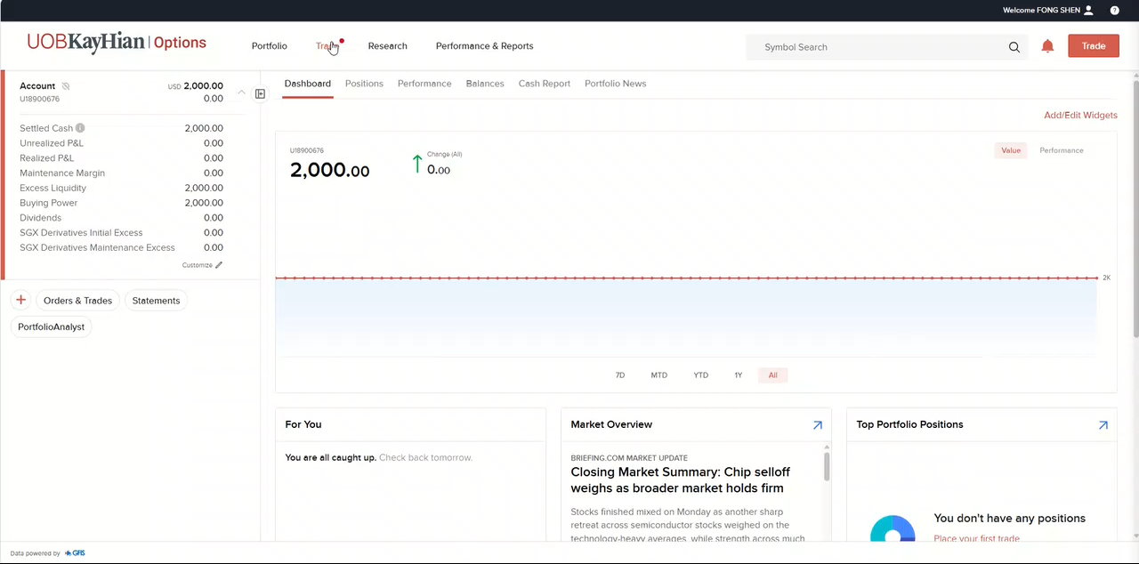
How do I amend or cancel an order
Trade
Click “Trade” > “Orders & Trades”
Select the order you would like to amend or cancel
Click the three-dot menu and select “Cancel” or “Amend”.
To modify an order: Update the required order parameters and click “Submit Amend Order”.
To cancel an order: Click “Cancel” to cancel the order.
Note: 1 option contract typically represents 100 shares of the underlying stock.

Slide 12
Watchlist
Create and monitor selected securities, track their prices and market movements, and access related news. You can also use your watchlist to filter the Events Calendar for relevant corporate events, such as earnings, dividend ex-dates, corporate actions and other upcoming events.

Slide 13
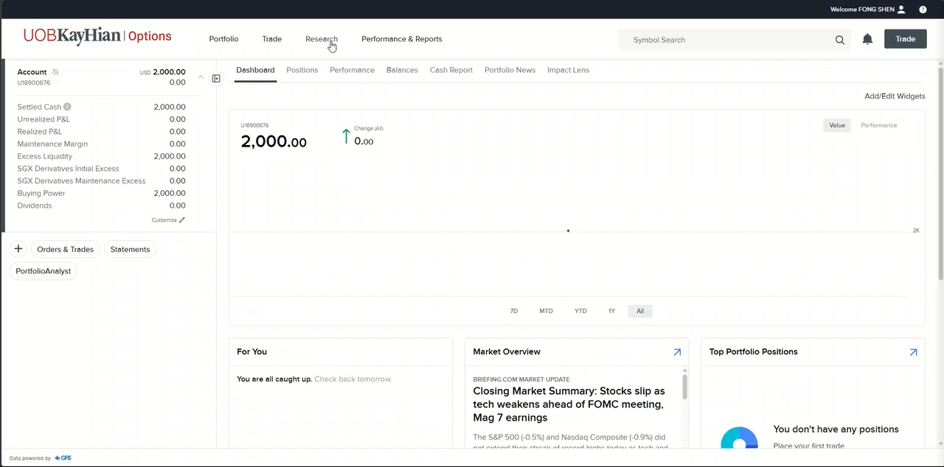

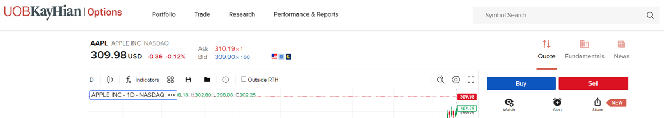
How do I create a new Watchlist?
Watchlist
Click on “Research” > “Watchlist”
On the left panel, click “New Watchlist”
Enter your preferred watchlist name
Enter the company name or symbol you would like to add to the watchlist
Select either Stock or Options
Click “Save”
The newly created watchlist will be displayed on the left panel.
Alternatively:
Enter the stock symbol in the Symbol Search field
Click “Watch”
Select “New Watchlist”
Enter your preferred watchlist name, then click “Save”.

Slide 14
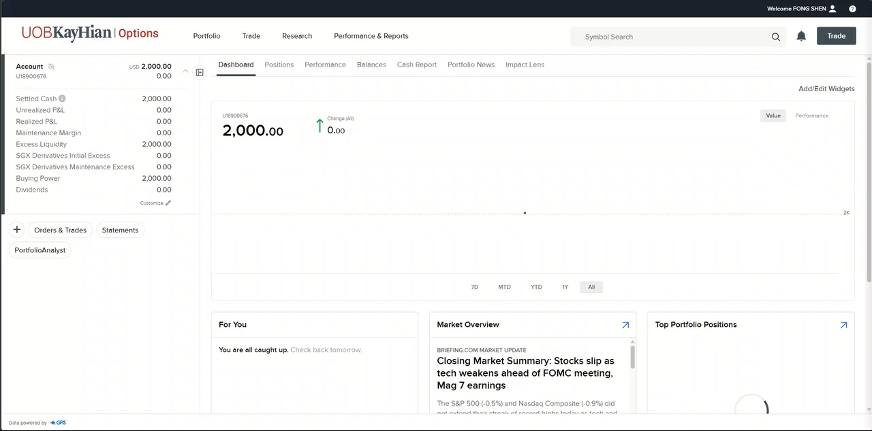
How do I delete an existing Watchlist?
Watchlist
Click on “Research” > “Watchlist”
On the left panel, select the watchlist you would like to delete
Click on the pencil icon
Click on “Delete List”
Click on “Yes, Delete” to confirm
The watchlist will be removed from the left panel.

Slide 15
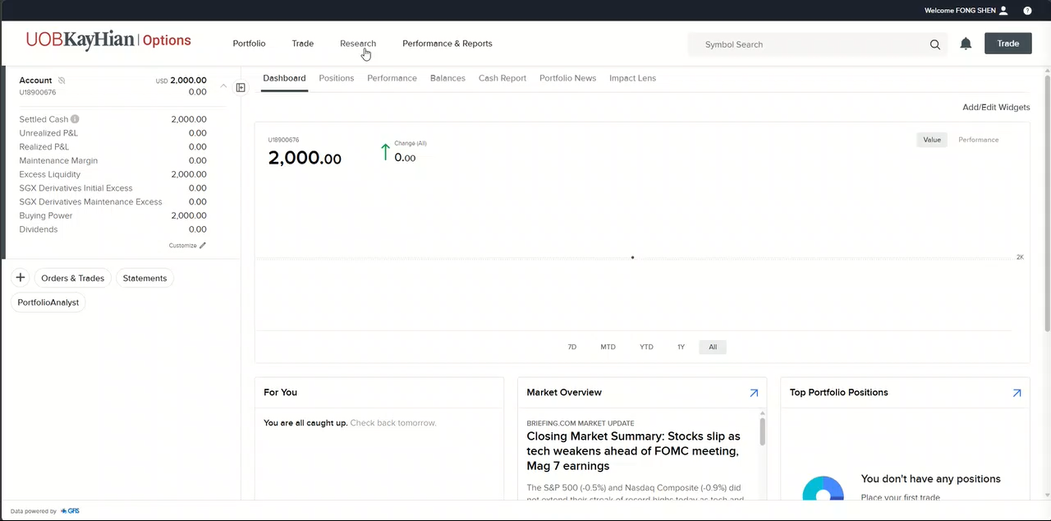
How do I add symbol to my watchlist?
Watchlist
Click on “Research” > “Watchlist”
On the left panel, select the watchlist you would like to add symbols
Click on the pencil icon
Click on “Add/Edit Symbols”
Enter the company name or symbol you would like to add to the watchlist
Select either Stock or Options
Click “Save”
Alternatively:
Enter the stock symbol in the Symbol Search field
Click “Watch”
Select the watchlist you would like to save the stock to, then click “Save”

Slide 16
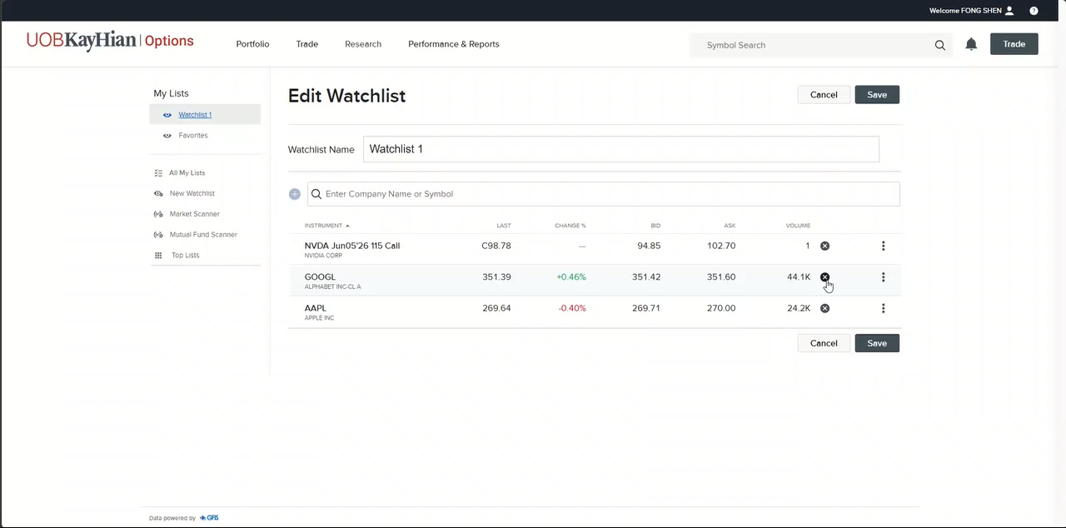
How do I delete symbol from my watchlist?
Watchlist
Click on “Research” > “Watchlist”
On the left panel, select the watchlist you would like to delete symbols
Click on the pencil icon
Click on “Add/Edit Symbols”
Find the instrument that you would like to delete
Click on the delete button
Click “Save”

Slide 17
Thank you
Contact
83 Clemenceau Avenue, #10-01, UE Square
Singapore 239920
info@uobkh.com
uobkh.com

